Slide 1
Investment Consideration for Major Music Streaming Platforms
Henry Ajagbawa, Muhammad AlOthman, Karina Diekema, Anthony Farhat, Rudrang Vora

Slide 2



Introduction
The music streaming industry in the United States alone was valued at $22.2 billion in 2020 and is estimated to continue increasing at a rapid pace. This value is largely driven by major players like Apple Music, Amazon Music, and Spotify. Due to the potential value that the music industry could bring to our investment firm, we performed an analysis on the three major platforms to determine which platform provided consumers the most positive experience and is most likely to continue to meet consumers expectations as the industry continues to grow. This analysis allowed us to determine the best platform to invest in to provide the largest return on investment to the firm.

Slide 3



Business Use Case
This analysis will help determine which major music application would be the better investment decision. While Apple Music and Amazon Music are just small segments of larger corporations, the analysis will still aid in assessing the health of these applications and will provide insights into consumer satisfaction and ultimately influence investment decisions in the corporations as a whole.
Understand consumer sentiment regarding each platform
Identify the drivers of consumer sentiment for each platform
Assess health and evaluate future potential for each platform

Slide 4
Approach
We took a three step approach to our analysis to ensure we gathered a holistic understanding of the problem and to offer the best recommendations based both on current and future state of the applications.
Data Cleaning & Preparation
Sentiment Analysis
Classification
We attempted several different classification models to discover the best fit for our data. We used a traditional “bag of words” model as a baseline before attempting more advanced classification techniques such as spaCY and BERT.
We began with basic pre-processing of data including stop word removal, stemming and lemmatizations, and removing null and missing reviews, as well as character cleaning to remove malformed characters from analysis.
We utilized TFIDF vectorization along with cosine similarity in order to identify drivers of positive, negative, and neutral sentiment

Slide 5





Data Cleaning & Preparation
With the exception of our more advanced BERT model, we took multiple steps to clean and prepare the data to ensure all other analysis and models would provide the most meaningful insights & forecasts.
Removed emoji encodings and malformed characters
Removed data entries with missing reviews
Identify the core driver of each review and remove unnecessary noise
Identified and removed stopwords (in addition to common english words, words like application, music, song, etc.)
Stemmed and lemmatized review vocabulary to reduce dimensionality

Slide 6




Sentiment Analysis
Using TFIDF Vectorization, we analyzed consumer reviews for Apple Music, Amazon Music, and Spotify.
These reviews were scraped from the Apple App Store and the Google Play Store and range from a rating of 1-5. The Apple App Store reviews also included insights from the review title
For TFIDF Vectorization, we chose a tri-gram for our analysis because it provided the best understanding of the motive behind consumer’s positive and negative reviews while also maintaining a small vector size.
We only considered the the words that appeared in more than 1% of documents to reduce dimensionality.

Slide 7
Positive Sentiment Analysis
Apple Music
Consumers frequently noted the lack of advertisements, the great sound quality due to spatial audio, and the iPhone home screen widgets when writing a positive review.
Amazon Music
Positive feedback revolves around Amazon music being included with Prime, the ability to listen offline, Alexa compatibility, and sound quality.
Spotify
Consumers were pleased with the ability to skip songs, view lyrics of songs being played and the high sound quality while using Spotify.

Slide 8
Negative Sentiment Analysis
Apple Music
Consumers generally were unsatisfied due to the app’s performance, new updates negatively impacting the platform’s performance, and issues with creating and using playlists.
Amazon Music
The top complaints for Amazon music revolved around poor performance following updates, a bad user interface that can also be slow or glitchy, and the usability of the offline mode capability.
Spotify
Top Spotify complaints revolved around advertisements and lack of song choice for the free version, negative impacts on performance due to updates, and lack of car mode while listening..

Slide 9
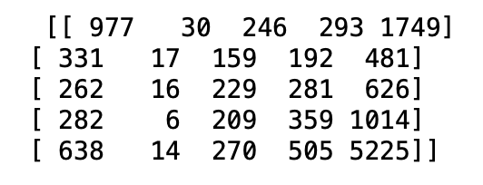
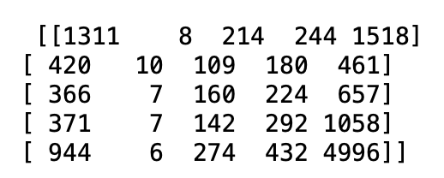
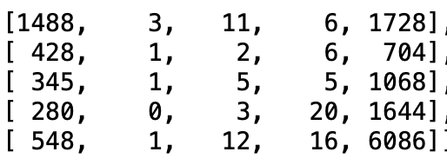
Classification I: Operation “Beat BERT” (failed)
CountVectorizer Tf-idf Vectorization
spaCy
Approach 1*
Accuracy: 47.23%
“1-off” Accuracy: 64.9%
Precision* = 42.04%
Recall** = 47.24%
F1-Score = 44.49%
Bag of words processes
Cleaning & Stemming
Looping through to find best features for bag of words models
Using different train_test_splits to assert our feature selection maximized accuracy
Assessing confusion matrices to see where models misclassified
Accuracy: 46.97%
“1-off” Accuracy: 63.63%
Precision* = 41.98%
Recall** = 46.97%
F1-Score = 44.34%
Using spaCy (sm), we achieved:
Accuracy: 52.74%
“1-off” accuracy: 67.32%
F1-Score: 42.37%
Our confusion matrix (below) however showed that this model was predicting mostly 1 or 5 for our reviews. One issue we ran into was that spaCy was extremely computationally heavy
Approach 2**
We learned sklearn.metrics has a package f1_score. We looped through different parameters for max_features, max_df, binary (note, we did not use min_df since it was giving errors on the test set), and seeds for train_test_split. This was computationally heavy but assured our results were accurate.
Overall, using different parameters with looping, we improved our F1-Score by a maximum of 1%. This means that the parameters we chose in Approach 1 were close to the optimal values for our bag of words models. Here were the parameters for both Count and TfIdf vectorization:
ngram_range = (1,2) ; stopwords; max_features = 100; min_df = 2; binary = True
It is important to note here that although out accuracy was higher than our bag of words models, our “1-off accuracy was only a couple of percentage points higher than our bag of words models. On top of this, our F1-Score was lower than our bag of words models. This can also serve as an example where accuracy isn’t everything and other metrics are needed to evaluate a model.
*See: Classification (Team 1) > Traditional classification approach.ipynb
**See: Classification (Team 1) > Optimized Bag of Words.ipynb

Slide 10
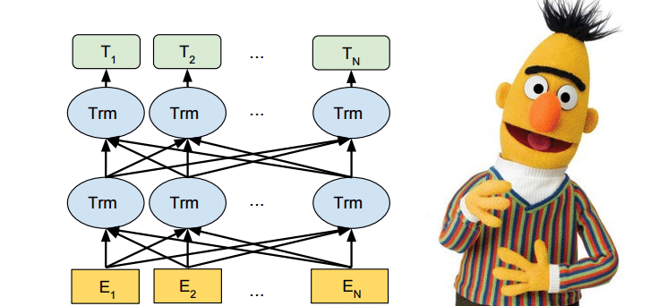
Classification II: BERT
In addition to the earlier models we considered, we decided to leverage the current state-of-the-art framework for many NLP tasks- the transformer-based BERT.
After removing NaN’s, encoding reviews, then passing the tokens to our model, we were good to go..
Some key metrics are:
Accuracy: 61%
“1-off” Accuracy: 85.6%
Precision* = 65%
Recall** = 61%
F1-Score = 63%
Our BERT model which utilizes dynamic (contextual) embedding performed really well compared to other traditional (bag-of-words) models and models like spacy (which utilize static word embeddings). It also performed not too far off the state-of-the-art benchmark for exact accuracy (67%) and off-by-1 accuracy (95%) as can be seen here.
Examining the wrong predictions, certain reviews where the user's score completely differed from the comment they actually left is what is limiting our model to the already high 61% accuracy and 85.6% off-by-1 accuracy. An example from the dataset is the review "I hate only ads XD". Without more context, this sentiment could be difficult even for a human to classify. As the review is talking about hating ads, our model predicted a sentiment of 1 but actually the real review score here was 5. Subjectively thinking about this, it may seem that the reviewer actually 'loves' the product, but only wrote about the part of the product they didn't like. It would be extremely difficult to pick up the correct sentiment in this case without more context. With this in mind, overall we were happy with our model’s performance.
See: Classification (Team 1) > Final_sentiment_classification_model_one_BERT.ipynb to dive into the analysis

Slide 11

Classification Results & Takeaways
Model | Accuracy | “1-off” Accuracy | F1-Score
CountVectorize | 47.23% | 64.9% | 44.49%
TfIdfVectorize | 46.97% | 63.63% | 44.34%
Spacy (sm) | 52.74% | 67.32% | 42.37%
BERT | 61% | 85.6% | 63%

Slide 12



Limitations
Not considering emojis in initial analysis could make our understanding of consumer feelings less clear however we sacrifice this for interpretability. Also some consumers leave bad reviews but give 5 stars.
Unable to account for slang, misspellings, or synonyms when doing sentiment analysis so their may be some friction points or points of satisfaction that we are missing.
Computation capability (looping for bag of words models, spaCy, BERT) made things take long to run

Slide 13
Recommendations
Based on sentiment analysis, Spotify received the least amount of complaints over the performance of the application and is the only application we considered that has a free model, but the free version received the majority of complaints from consumers. Spotify is also the only music streaming focused app which makes it more likely to continue to focus on pleasing consumers in that regard where the larger companies may not be as focused on that side of the business.
By leveraging our final classification model (BERT) we can successfully adapt to changing consumer sentiment and continue monitoring our investment in Spotify, by applying it to future app store review data to continuously differentiate between the streaming platforms and ensure Spotify remains a preferred platform. We can later extend its use to other alternative text data sources, such as real-time twitter feeds, to aid sentiment analysis pipelines, investment decisions and portfolio allocation.

Slide 14
Conclusion
With 83% of the music industry’s revenue stemming from streaming, heavy consideration should be taken in investing in one of the core streaming platforms. We analyzed the three leading streaming platforms, Apple Music, Amazon Music, and Spotify, using sentiment analysis and sentiment forecasting models to determine the platform that fulfills it’s users needs the best. This analysis leads us to recommend investing in Spotify due to the positive consumer opinions regarding the platform, especially compared to large competitors.

